Slide 1
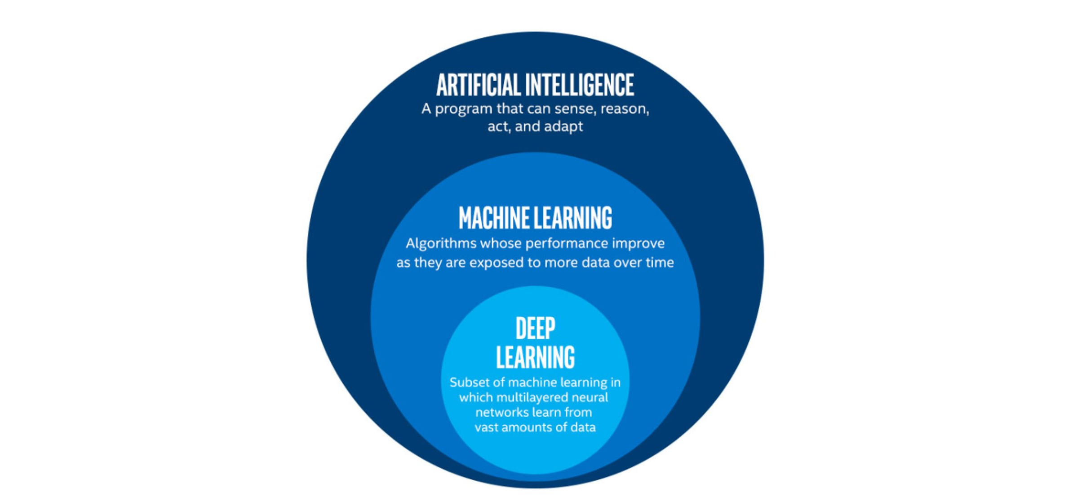
Intro to Deep Learning
Dr. Nidhi Gowdra

Slide 2
Agenda
Day 1
Introduction
Break (10 Min)
Classification (Penguins Dataset)
Break (15 Min)
Prediction (Weather Dataset)
Q&A
Day 2
Q&A
Prediction Continued (Tune HPs)
Break (15 Min)
Classification using CNNs
Break (15 Min)
Tune CNN HPs
Closing

Slide 3

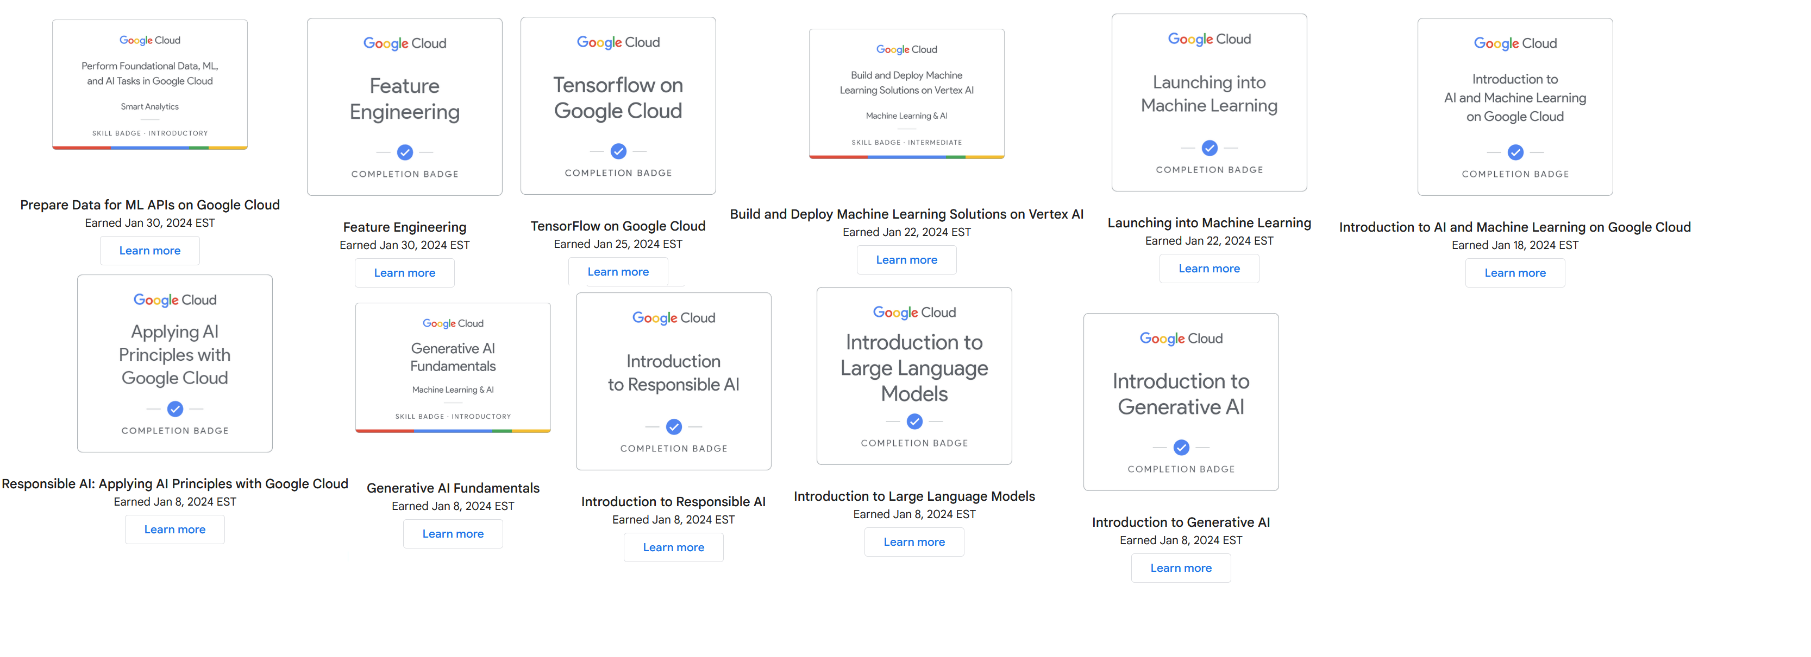

Who are we?
Nidhi Gowdra (Ph.D. in Deep Learning)
eResearch solutions specialist at CeR.
Nvidia University Ambassador
Nvidia Certified Instructor (Deep Learning Institute) for Deep Learning.
8+ years of experience in AI/ML/DL.

Slide 4
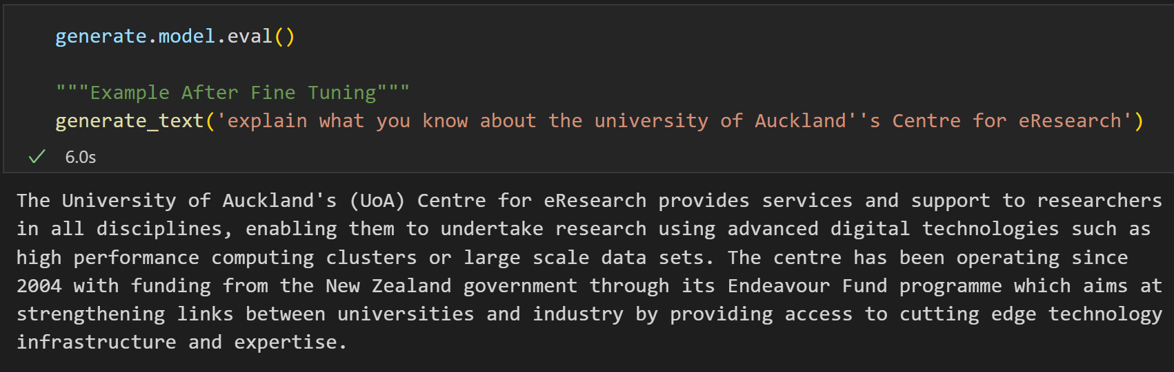
Applications of Deep Learning
Large-Language Models (LLMs)
Most of you might have already heard about ChatGPT, Gemini etc.?
An example below, of a local Retrieval Augmented Generation (RAG) model – Mistral7B.

Slide 5
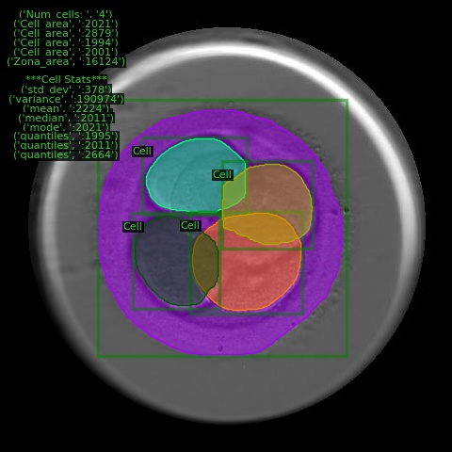
Applications of Deep Learning
Classification and Segmentation of Bio-Medical Images
Sometimes it’s necessary to identify more than just how many cells there are in an image.
Segmentation using DNNs can help visualize and identify the segmented cells including regions of interest.
Imagine having to manually segment all these images! (~1,000,000+)

Slide 6
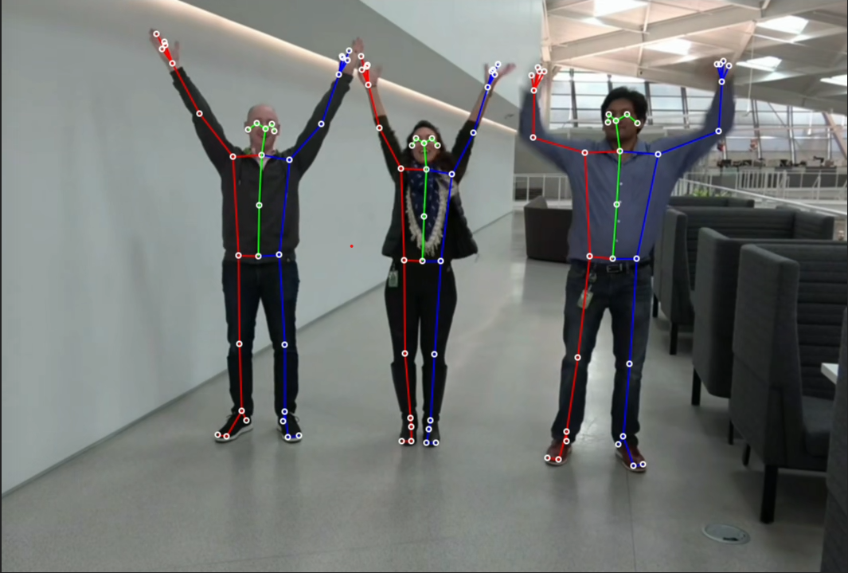
Applications of Deep Learning
Human pose/gait movement identification
Traditional approaches using statistics/ML can’t compare to DL approaches such as PoseNet/3DPoseNet/BodyPoseNet etc.
Applications for this tech includes game motion capture, Sport science, robotic/humanoid movement.
Fig 1: Nvidia demo of bodyposenet
Many more applications where DL is superior, conversely others where it is not.
Choose your tools accordingly, if all you have is a hammer every problem is a nail.
Fig 1. https://catalog.ngc.nvidia.com/orgs/nvidia/teams/tao/models/bodyposenet

Slide 7
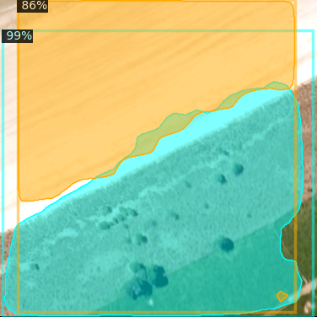
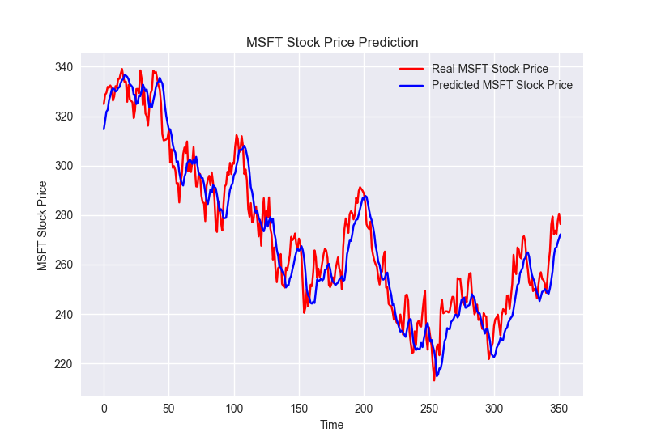
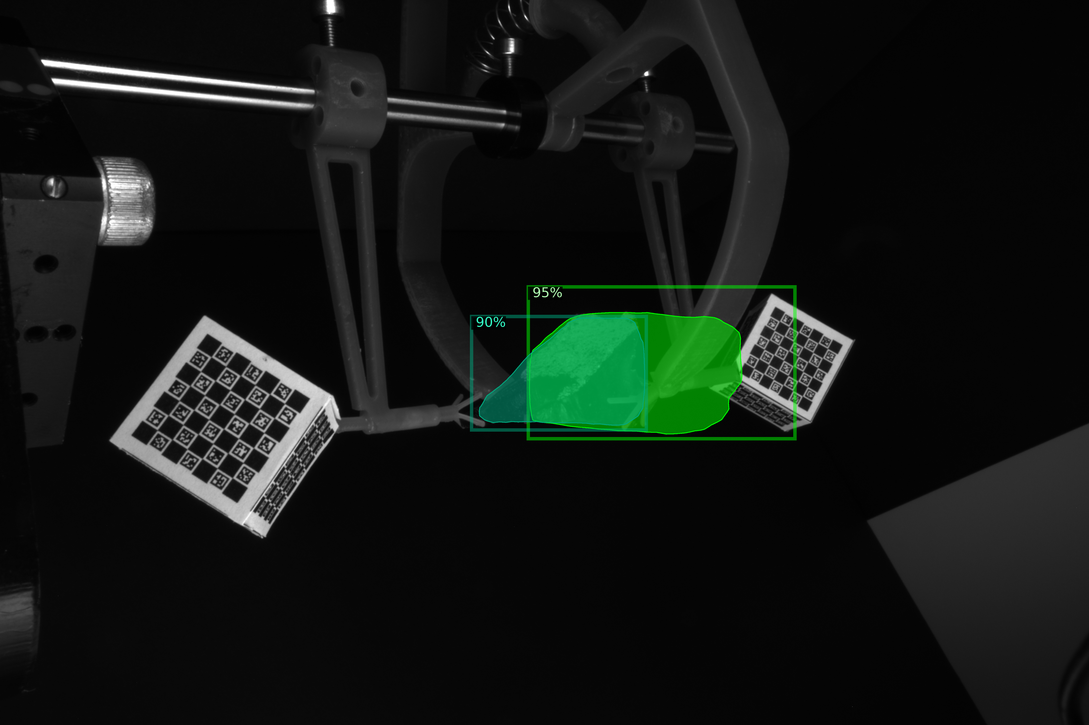
Applications of Deep Learning
Many more…
Fig: Archaeology artefact identification and reconstruction, Coastal erosion regression, stock price prediction

Slide 8
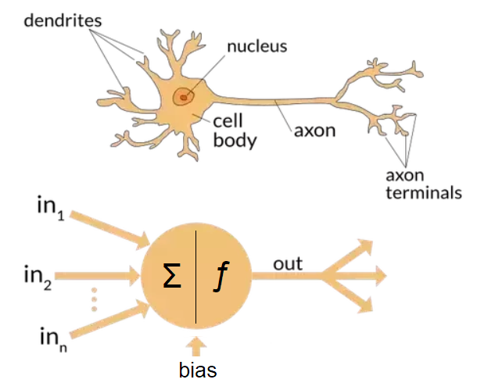
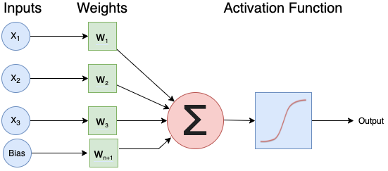
Perceptron and its outputs
What is the output of the neuron?
X = [0, 0.5, 1];
W = [-1, 0.5, 0];
Bias = 1
Activation Function: f(X) = max(X, 0); (This is the Rectified Linear Unit (ReLU) activation function)

Slide 9
Perceptron and its outputs
Solution
What is the output of the neuron?
X = [0, 0.5, 1];
W = [-1, 0.5, 0];
Bias = 1
(0*-1) + (0.5*0.5) + (0*1) = 0.25 + bias (1) = 1.25
Activation Function: f(X) = max(X, 0) i.e. max (1.25, 0)
Final Output = 1.25

Slide 10
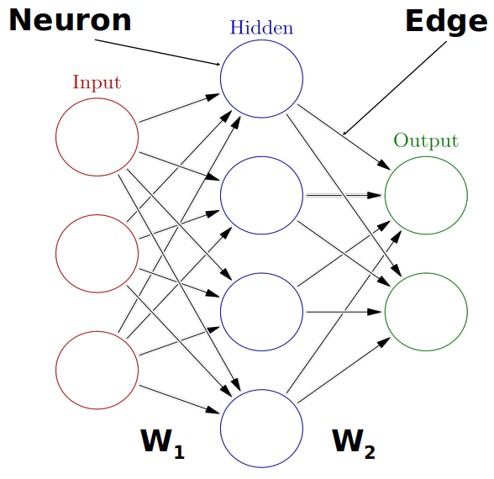
A Single Layer Neural Network
Weights: Used to map the representation between inputs and
outputs, they are floating numbers that dynamically
adjust throughout the training process.
Inputs: Data, images, text, videos etc.
Activation Func: Needed to achieve non-linear representations,
i.e. f(x) = max(x, 0)
Outputs: Probabilities, Numbers or Text.
Fig: An illustration of a single Dense layer

Slide 11
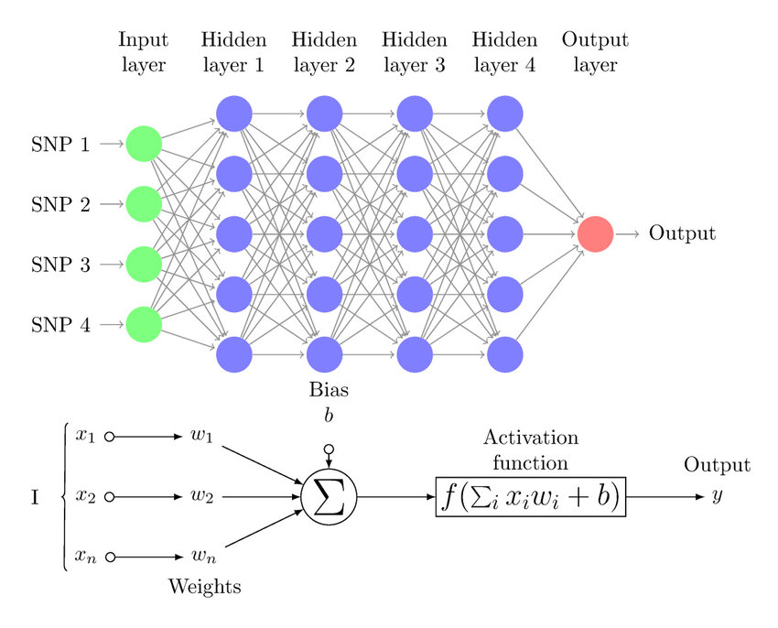
Deep Neural Networks
Why Deep?
Deep NNs (DNNs) are called as such because they have multiple hidden layers stacked on one another.
DNNs can extract richer feature information compared to shallow NNs due to their ability to extract non-linear representations.

Slide 12
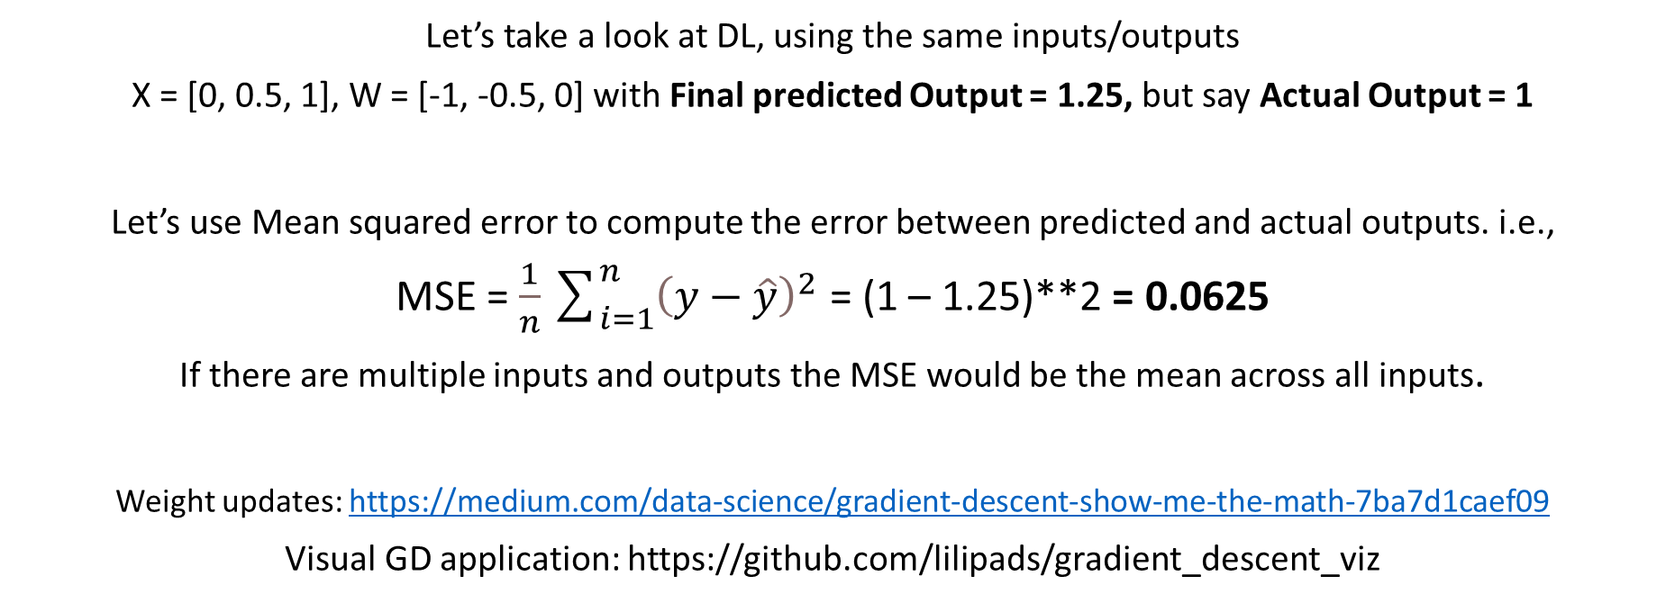
How do NNs learn?
Let’s take a look at DL, using the same inputs/outputs
X = [0, 0.5, 1], W = [-1, -0.5, 0] with Final predicted Output = 1.25, but say Actual Output = 1
Let’s use Mean squared error to compute the error between predicted and actual outputs. i.e.,
MSE = $\frac{1}{n}\sum_{i=1}^{n}{{\left(y−\hat{y}\right)}^{2}}$ = (1 – 1.25)**2 = 0.0625
If there are multiple inputs and outputs the MSE would be the mean across all inputs.
Weight updates: https://medium.com/data-science/gradient-descent-show-me-the-math-7ba7d1caef09
Visual GD application: https://github.com/lilipads/gradient_descent_viz

Slide 13
Can Deep Learning solve every problem?
Poll
Please complete the zoom poll on your screen.
Let’s discuss the answers after!

Slide 14
Software/Libraries
Commonly Used Deep Learning Libraries:
Tensorflow/Keras from Google Research.
PyTorch from Facebook/Meta AI Research.
We will be using Tensorflow/Keras.

Slide 15
Applying Deep Learning (Let’s code…)
Formulate/Outline the problem
Identify inputs and outputs
Prepare data
Choose a loss function and optimizer
Train the model
Perform a Prediction/Classification
Measure Performance
Tune Hyperparameters
Share/Deploy Model

